Slide 1

SPEED DETECTION VIOLATION

Slide 2
SPEED DETECTION VIOLATION
TEAM MEMBERS:
SWARNA L(20CSR220) B.E(CSE-III)
THAMIZ SELVAN A(20CSR224) B.E.(CSE-III)

Slide 3
The Problem
Speeding is regarded as a factor in nearly one-third of all fatal accidents on the roads.
To combat this dangerous and life-threatening behavior, there need to be systems implemented to target speeding vehicles.
Speed enforcement systems monitor speed on roads and highways and are more effective in increasing safety and smoothen traffic flow.

Slide 4
Idea Overview
Explain your idea(Product/Service)
Vehicles violating the Speed limit should be penalized by debiting money from the FastTag account.
Social
Usecase: Once the project is completed, it can be implemented on highways or some other important places where vehicle speed should be controlled like schools, colleges….etc
TRL 1

Slide 5
The Solution
The Speed Violation Detection System to detect Overspeed vehicles.
The system is used to calculate the estimated speed of a motor vehicle at a given prompt of time.
In a previous study, current speed detection technologies and methods are available which are more costly, and they can be able to detect only a single vehicle at a time.
Many different technologies are available to devise over-speed detection systems like radar or laser gun technologies are devised which are not so accurate and also are more costly.
The main goal of this idea is to study various technologies which are applicable for computer vision or sensor-based.
The input for such a system is required in the form of video and then the steps involved in estimating vehicle speed of the vehicle and displaying it as an output.
If a vehicle is detected with Overspeed, then the amount will be deducted from the “FASTag” account linked with that vehicle.

Slide 6
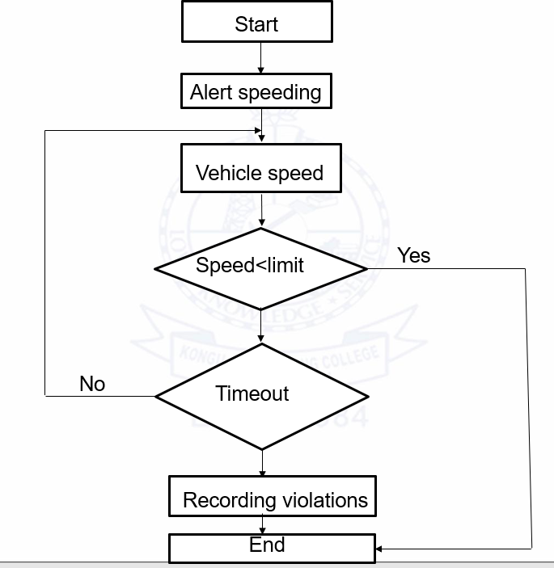
Flowchart

Slide 7
Idea - Current Status / Future Plan Timeline & Milestones
As of now we have only idea and in upcoming days we will start to implement
A maximum time of 4 weeks is required for product commercialization
We will use our prize money for our project related works

Slide 8
Customer Segment
The problem is faced by all citizens of India.
Our target customer is all State highways authority and National highways authority of India.
Government authority and some of the private sectors which uses our system will pay us.
It is business to customer.

Slide 9
Value Proposition
Our model will work efficiently under any circumstances. Our model provides accuracy using the three points to find the distance.
The current model will not detect vehicles traveling above a speed of 160km/Hr.
Our model will also detect the vehicles which are traveling above 160km/Hr or did not track the vehicles that are traveling below 20km/Hr(ie these vehicles are not necessary to monitor which is identified at the beginning, hence we are using three points to find the distance we can identify at the beginning).
We are using three points to identify the distance and using the distance we can able to find the speed.
No , IP or Patentable Component is not associated with the Solution

Slide 10
Channels (Marketing)
How will you reach your customers in a cost-effective manner?
What marketing method will you do to get customers?
Use Images / Photos / Video | Don’t just answer given points in slides | Avoid para | Use bullet points

Slide 11
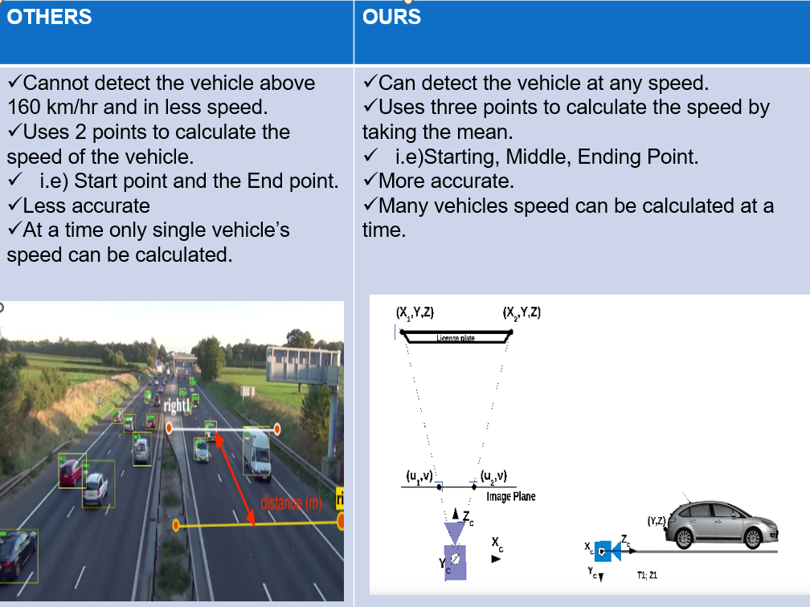
Competitors

Slide 12
Revenue Model
How do you plan to make money ? (Methods/ Modes /Means)
If you are working on social ideas, then how do it create an impact?
Use Images / Photos / Video | Don’t just answer given points in slides | Avoid para | Use bullet points

Slide 13
What help you expect from Us ?
Guidance for executing the idea
Appointment with an expert in the chosen field

